Slide 1
Plate Tectonics
Elizabeth M. Dowding
System Erde III
May, 2025

Slide 2
Elizabeth M. Dowding
PaleoSynthesis Postdoc
dowdingem@gmail.com
Palaeobiogeography
Spatial patterns of diversity
Bioregionalisation
Palaeogeography

Slide 3
Contents
Introduction to learning outcomes
History of the theory
Evidence for Plate Tectonics

Slide 4
Introduction to learning outcomes
Session 1
Introduction to theory
Session 2
Introduction to using GPlates
Practical guide to picking a plate reconstruction
Session 3
Using a plate reconstruction
Assignment
Group task
https://adamtkocsis.com/se3-gplates/

Slide 5
Schedule
Date | Length | Topic
May 8 Wednesday | (1h) | Introduction/Starting with GPlates
May 9 Thursday | (2h) | GPlates: rotations
May 21 Wednesday | (1h) | Raster data and single points

Slide 6
Technical Requirements
You will need a computer with Win, Mac or GNU/Linux
IPAD, Chromebooks will not work.
We will install GPlates together

Slide 7
Assignment
Practical exercise with GPlates
Short report (max. 3 A4 pages)
Assignment can be written in German
Due at the end of the lecture period (July 25) - necessary to pass the course
Due 25 July

Slide 8
Plate Tectonics
Notes:
Image from : https://www.geeksforgeeks.org/tectonic-plates/

Slide 9
Section 2: History of the theory
What are the different theories about Earth History?
What is the evidence?
What do we use it for?
5 Mins.

Slide 10
Different theories about Earth History?
Static Earth
Land Bridge
Expanding Earth
Continental Drift
Convection Current
Sea Floor Spreading
Polar Wander
Plate Tectonics
Continental Drift
Sea Floor Spreading
Plate Tectonics

Slide 11
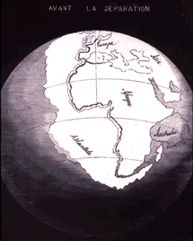
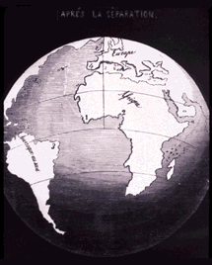
Static earth? Geometric Fit!
The continent outlines seem to match
Jigsaw puzzle
(Ortelius 1596): Thesaurus Geographicus
Lilienthal, Humboldt, Snider-Pellegrinii, Kious etc.
(Snider-Pellegrini 1858)

Slide 12
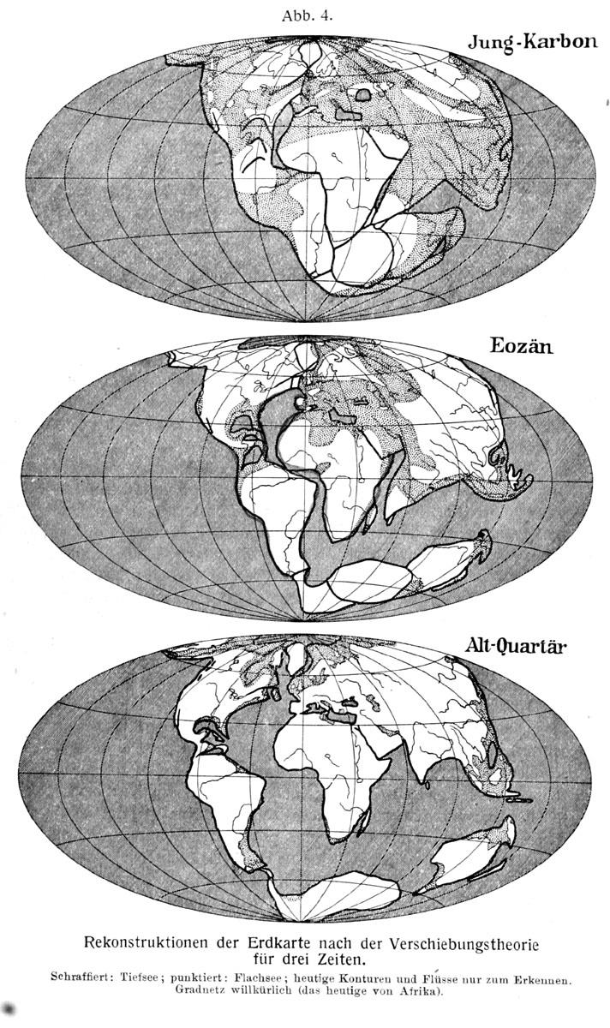
Alfred Wegener (1880-1930)
1912, Pangea
Die Entstehung der Kontinente (Wegener 1912)
Not fully accepted until 1970s

Slide 13
Why?
What do you need to know or assume before you develop continental drift theory (CDT)?
A good understanding of rock time
Good taxonomy
Good chronostratigraphy
Global scope (NO INTERNET! Invented in 1983)
Something is making and letting the rocks move
Notes:
This last point is not trivial. The ground is so solid and mountains so immovable and oceans so impassable.

Slide 14
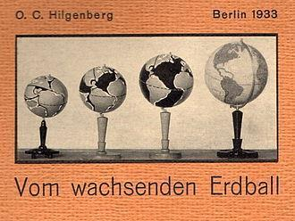
Other explanations?
Expanding earth

Slide 15
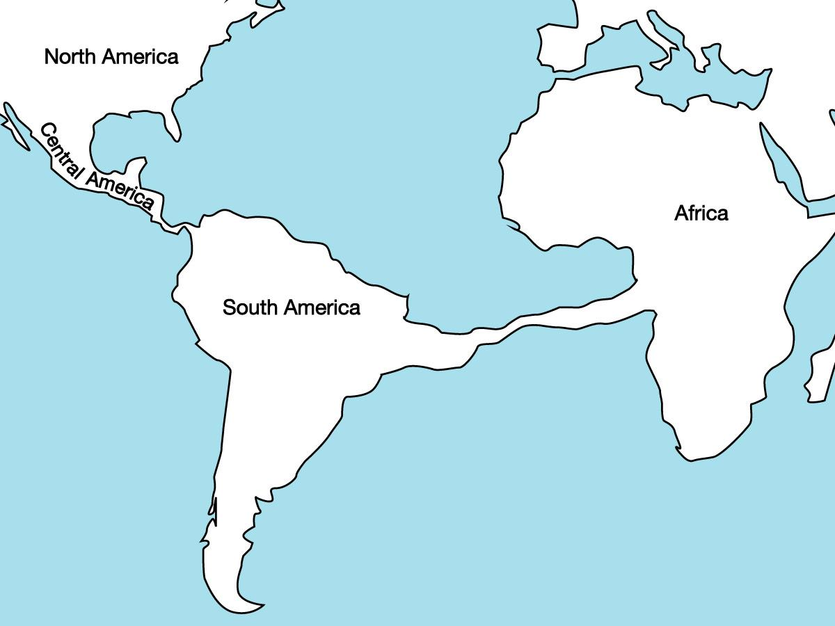
Other explanations?
Landbridges?

Slide 16
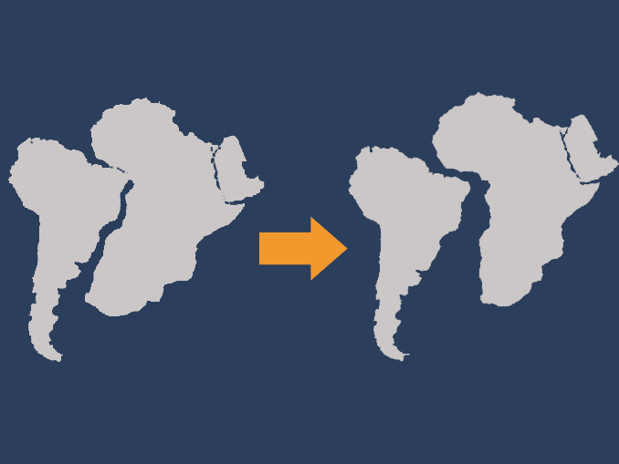
Continental Drift: What does it offer?
Notes:
What does CDT offer that landbridges, static earth, don’t?

Slide 17
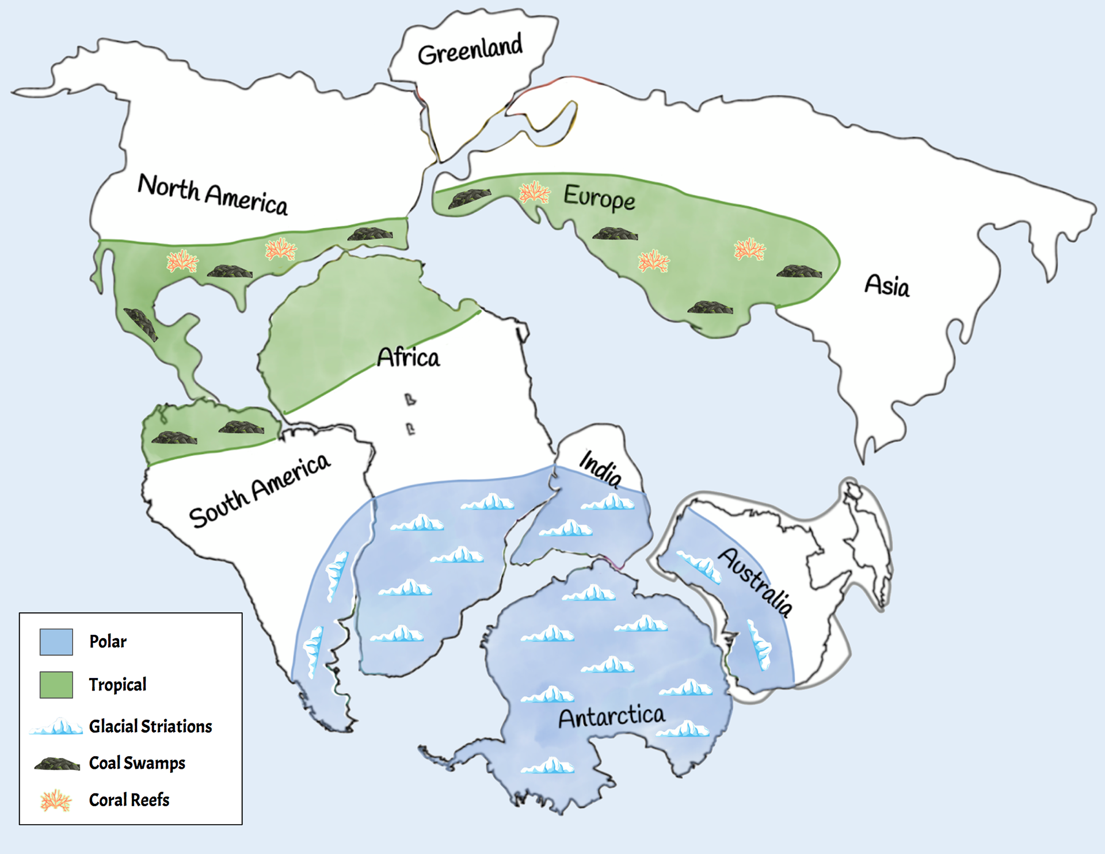
Notes:
Kristie McMahon A Global Puzzle - Online Store (pengoodet.live)

Slide 18
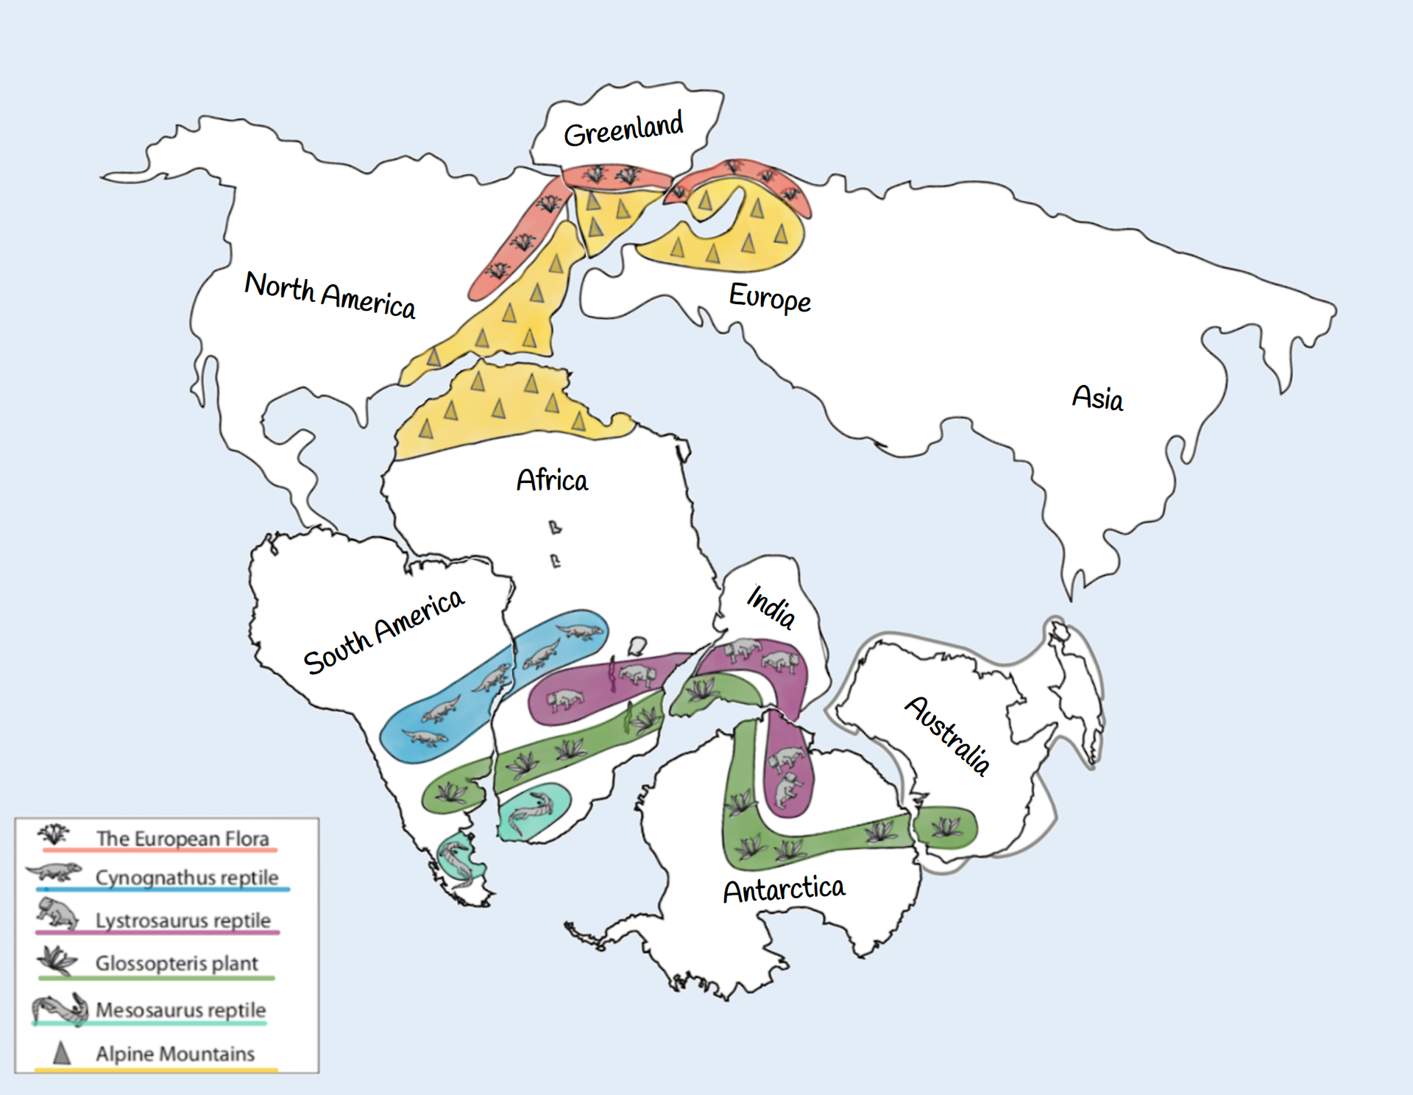
Notes:
20 Perceptive Pangaea Activities Teaching Expertise - Online Store (pengoodet.live)

Slide 19
CDT: What does it NOT offer?
Notes:
Mechanism

Slide 20
Mechanism!
Notes:
APW is earth relative.
TPW corrected for earths situation in the cosmos

Slide 21
Notes:
GeoLog | Marie Tharp: an inspiration for the past, present and future! (egu.eu)
1952! Many years after her initial discovery.

Slide 22
Notes:
GeoLog | Marie Tharp: an inspiration for the past, present and future! (egu.eu)

Slide 23
Sea Floor Spreading : Harry Hess, 1960
Seafloor spreading occurs at divergent plate boundaries. As tectonic plates slowly move away from each other, heat from the mantle's convection currents makes the crust more plastic and less dense. The less-dense material rises, often forming a mountain or elevated area of the seafloor.
Notes:
Lead to the Development of the Wilson Cycle

Slide 24
Notes:
A schematic highlighting the ocean-plate formation, cooling and destruction as part of the planet’s global mantle convection driven by the temperature gradient between its hot deep interior and the cold surface environment. Ocean-Plate Tectonics is the concept that describes not only the horizontal surface motion of the oceanic plate (grey arrow), but also highlights the pull from its subducted portion as the main driver (green arrow), distinguishes the oceanic plate (dark brown) from its continental counterpart, acknowledges the plate–mantle coupling that induces characteristic regional mantle-flow patterns (black flow lines), and describes the dynamics of the oceanic plate as part of the larger framework of global mantle convection that transports heat out of the interior (light-red arrow) due to the heat gradient between the planetary interior and outer space.
Creator: Fabio Crameri
This version: 22.09.2022
License: Attribution-ShareAlike 4.0 International (CC BY-SA 4.0)
Specific citation: This graphic by Fabio Crameri from Crameri et al. (2019) is available via the open-access s-Ink.org repository.
Related reference: Crameri, F., C.P. Conrad, L. Montési, and C.R. Lithgow-Bertelloni (2019), The dynamic life of an oceanic plate, Tectonophysics, 760, 107-135, doi:10.1016/j.tecto.2018.03.016

Slide 25
North East Atlantic Ocean Evolution
Sea Floor Spreading
Notes:
Opening of the North East Atlantic Ocean and dynamic support from the Iceland mantle plume. The Scientific colour maps ‘oleron’ and lajolla‘ is used to represent data accurately and to all readers.
Creator: Eivind O. Straume
This version: 03.09.2021
License: Attribution-ShareAlike 4.0 International (CC BY-SA 4.0)
Specific citation: This graphic by Eivind O. Straume is available via the open-access s-Ink repository.
Related reference: E.O. Straume, C. Gaina, S. Medvedev, and K.H. Nisancioglu (2020), Global Cenozoic Paleobathymetry with a focus on the Northern Hemisphere Oceanic Gateways, Gondwana Research, 86, 126-143. https://doi.org/10.1016/j.gr.2020.05.011

Slide 26
Ocean-plate age
Notes:
Maps of the age of oceanic plates, which varies between 0 and around 200 Ma due to ongoing plate motion and recycling (i.e., ocean-plate tectonics). Global ocean-plate age data from Müller et al. (1997) visualised on a custom Interrupted Mollweide map projection from Crameri et al. (2020) focussing on the World’s oceans. The Scientific colour map ‘batlow‘ is used to represent data accurately and to all readers.
Creator: Fabio Crameri
This version: 20.08.2021
License: Attribution-ShareAlike 4.0 International (CC BY-SA 4.0)
Specific citation: This graphic by Fabio Crameri from Crameri et al. (2022) is available via the open-access s-Ink.org repository.
Related references: Crameri, F., G.E. Shephard, and E.O. Straume (2022, Pre-print), Effective high-quality science graphics from s-Ink.org, EarthArXiv, https://doi.org/10.31223/X51P78 Müller, R. D., et al. (1997). “Digital isochrons of the world’s ocean floor.” J. Geophys. Res. 102(B2): 3211-3214. Crameri, F., V. Magni, M. Domeier, G.E. Shephard, K. Chotalia, G. Cooper, C. Eakin, A.G. Grima, D. Gürer, A. Király, E. Mulyukova, K. Peters, B. Robert, and M. Thielmann (2020), A transdisciplinary and community-driven database to unravel subduction zone initiation, Nature Communications, 11, 3750. doi:10.1038/s41467-020-17522-9

Slide 27
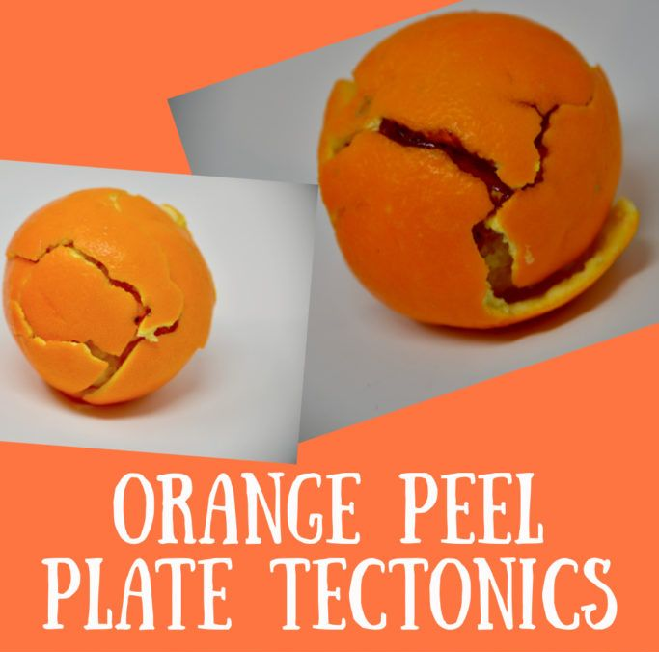
Notes:
Plate Tectonics is simple: is the name of a scientific theory that Earth's lithosphere comprises a number of tectonic plates, which have been moving since the development o about 3.4 billion years ago. The model builds on the concept of continental drift, an idea developed during the first decades of the 20th century.

Slide 28
The Wilson Cycle
How to make and unmake Pangea
Notes:
The birth of ocean basins, the death of plates.

Slide 29
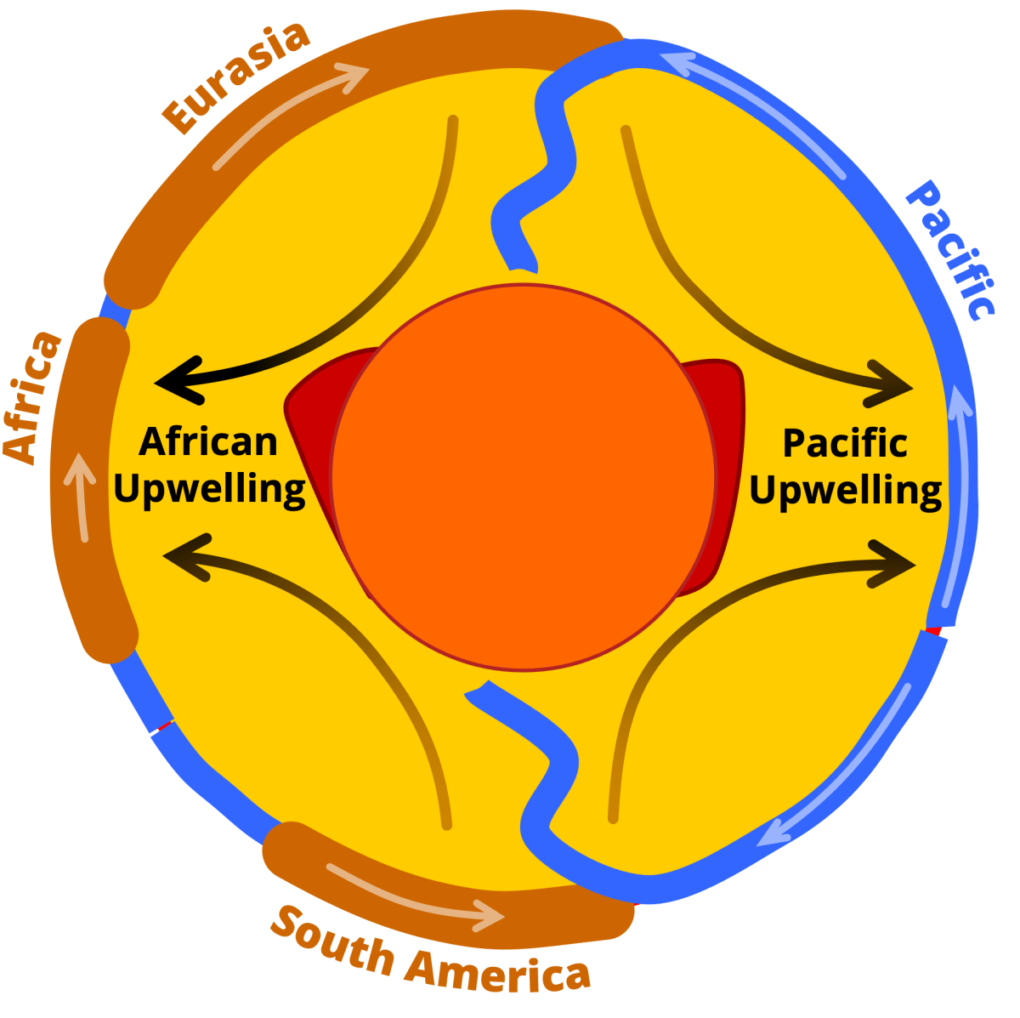
Notes:
A sketch outlining the link between the viscous convection within the Earth’s mantle and tectonic surface plate motions, deforming Earth’s surface across wide areas. Shown are the relative positions and motion of some of Earth’s continental (brown) and oceanic plates (blue) captured by the hypothetical cross-section through the middle of the planet. The dynamic link between surface and mantle motion is highlighted by arrows representing first-order material flow direction. This global-scale mantle flow is believed to also affect the shape, position and mobility of large low shear-velocity provinces (LLSVPs; red) at the base of the mantle (yellow) just above the Earth’s core (orange).
Creator: Clint P. Conrad
This version: 01.09.2021
License: Attribution-ShareAlike 4.0 International (CC BY-SA 4.0)
Specific citation: This graphic by Clint Conrad based on Conrad et al. (2013) is available via the open-access s-Ink repository.
Related reference: Conrad, C., Steinberger, B. & Torsvik, T. Stability of active mantle upwelling revealed by net characteristics of plate tectonics. Nature 498, 479–482 (2013). https://doi.org/10.1038/nature12203

Slide 30
What is the Difference?
Notes:
CDT, no subduction. No plate destruction. No plate reformation. No seafloor spreading.

Slide 31
What is the Difference?
Subduction
Plate destruction
Plate formation
Sea floor spreading
Geodynamics
Slab dynamics
Mantle heterogeneity
Core to Palaeomagnetic field inclusive
Notes:
CDT, no subduction. No plate destruction. No plate reformation. No seafloor spreading.

Slide 32
What is the Evidence?
Part 3
Notes:
What is the evidence for all the stuff I just mentioned?

Slide 33
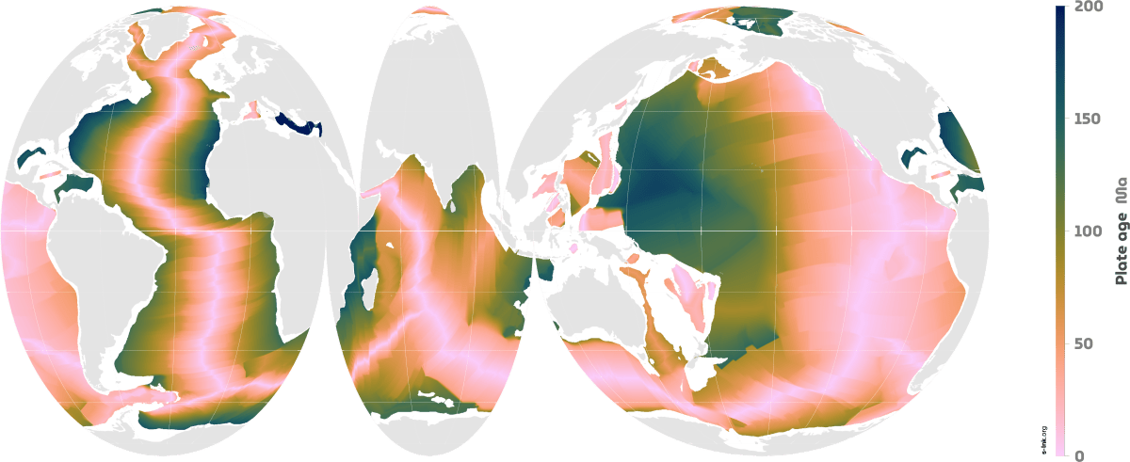
Wilson Cycle: Ocean floor age
Notes:
No seafloor older than 200ma : but we have fossils on cratons far older

Slide 34
Seismic mantle tomography maps
Notes:
Surface projected global horizontal seismic S-wave velocity anomaly maps for different mantle depths revealing the two large low shear-wave velocity provinces (LLSVPs) below the Pacific (named Jason) and Africa (named Tuzo). Shown is the S10MEAN model based on Doubrovine et al. (2016) averaging 10 tomography models allowing to compare relative variations in S-wave velocity. The Scientific colour map ‘batlow‘ is used to represent data accurately and to all readers.
Creator: Fabio Crameri
This version: 31.10.2021
License: Attribution-ShareAlike 4.0 International (CC BY-SA 4.0)
Specific citation: This graphic by Fabio Crameri based on data compiled by Doubrovine et al. (2016) is available via the open-access s-Ink repository.
Related references: Doubrovine, P. V., Steinberger, B., and Torsvik, T. H. (2016), A failure to reject: Testing the correlation between large igneous provinces and deep mantle structures with EDF statistics, Geochem. Geophys. Geosyst., 17, 1130– 1163, doi:10.1002/2015GC006044.

Slide 35
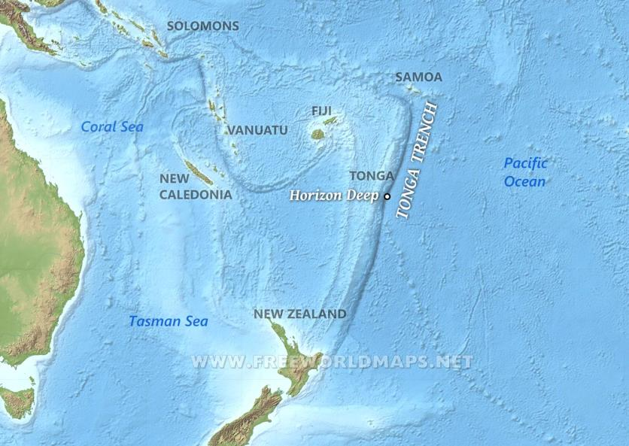
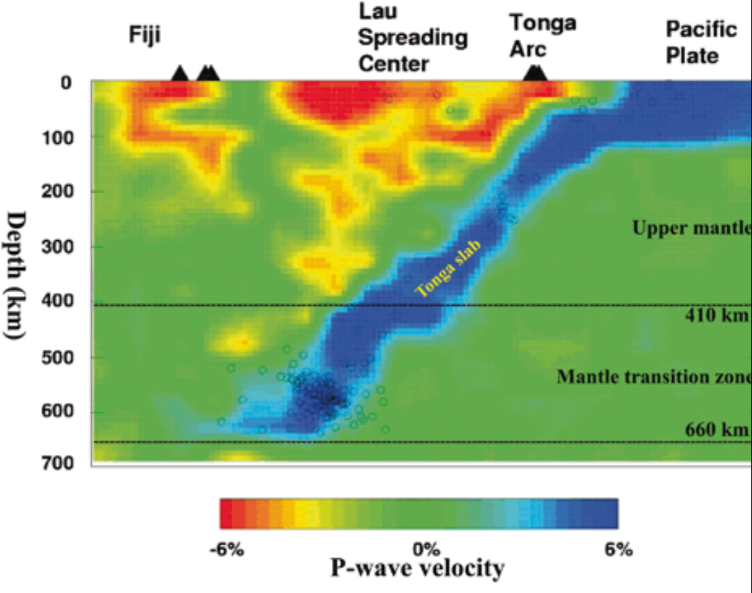
Tomography: Evidence for subduction

Slide 36
Relative plate velocities
Notes:
http://www.mantleplumes.org/Hotspots.html

Slide 37
Lu et al 2021
Notes:
West coast us moving at 13mm per year. Inland 2mm per year. What do you think will happen soon in the west coast USA?
DOI: 10.26464/epp2021014

Slide 38
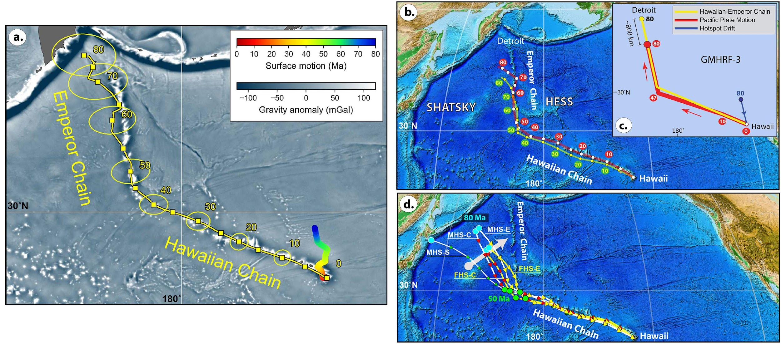
Plates move above a hotspot
Notes:
Torsvik et al, 2019

Slide 39
What if it's older than 220Ma?
Notes:
No seafloor older than 200ma : but we have fossils on cratons far older

Slide 40
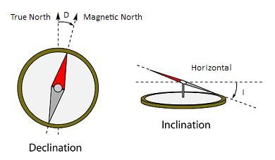
Geomagnetism and Palaeomagnetism
The Geocentric Axial Dipole (GAD)
Notes:
Declination is the difference between the geographic and magnetic north.
The magnetic inclination is the angle between the earth's surface and the magnetic field lines.

Slide 41
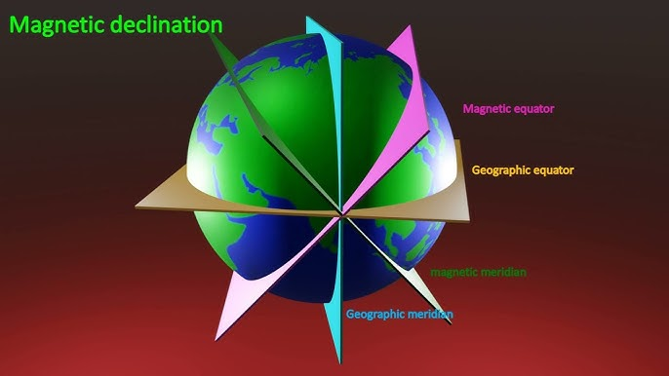

Slide 43
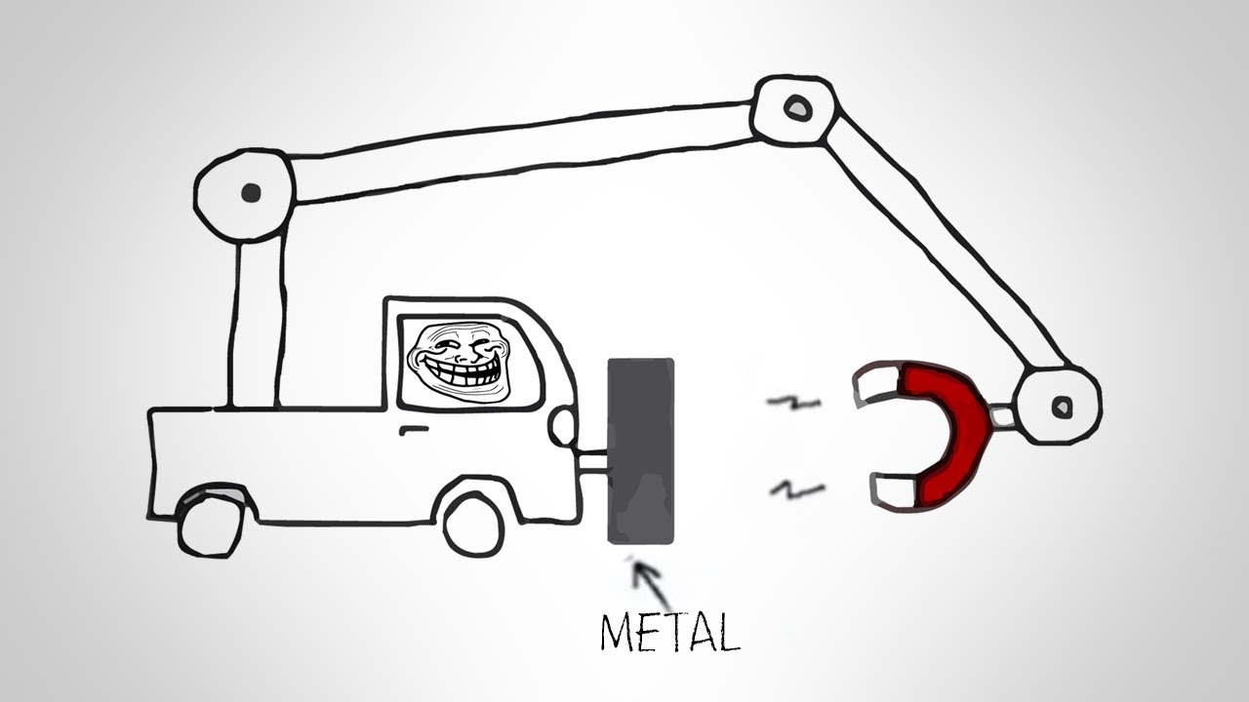

Slide 44
But how?

Slide 45
The Geodynamo Hypothesis
The dynamo theory describes the process through which a rotating, convecting, and electrically conducting fluid can maintain a magnetic field over astronomical time scales
Proposed to have existed as early as 3Byr
It results in the Earth’s GEOCENTRIC AXIAL DIPOLE
Notes:
Geodynamo (ucsc.edu)

Slide 46
In GAD we trust
Reversals can happen within 1000 years
Currently observed every 20 000 years or so according to the three-dimensional numerical simulation of the geodynamo, run at the Pittsburgh Supercomputing Center and the Los Alamos National Laboratory
Notes:
But they generally take a couple of thousand
Geocentric axial dipole.

Slide 47
Notes:
A snapshot of the 3D magnetic field structure simulated with the Glatzmaier-Roberts geodynamo model. Magnetic field lines are blue where the field is directed inward and yellow where directed outward. The rotation axis of the model Earth is vertical and through the center. A transition occurs at the core-mantle boundary from the intense, complicated field structure in the fluid core, where the field is generated, to the smooth, potential field structure outside the core. The field lines are drawn out to two Earth radii. Magnetic field is rapped around the "tangent cylinder" due to the shear of the zonal fluid flow (Fig. 1)

Slide 48
Notes:
at the middle of the reversal

Slide 50
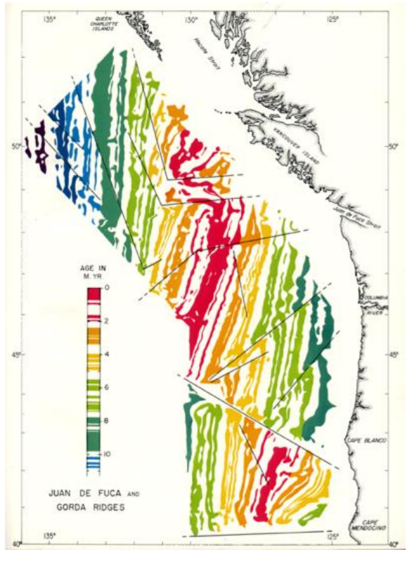
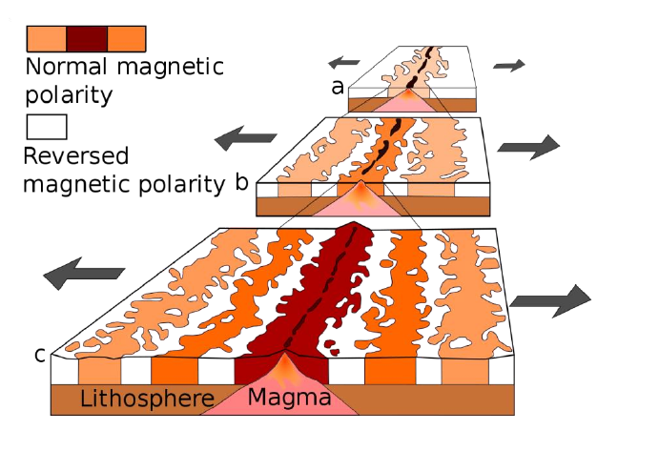
Palaeomagnetic stripes

Slide 51
Where does the data come from?
Notes:
08-Paleomagnetism principles and applications - Bet Beamund_ed2 (ub.edu)

Slide 52
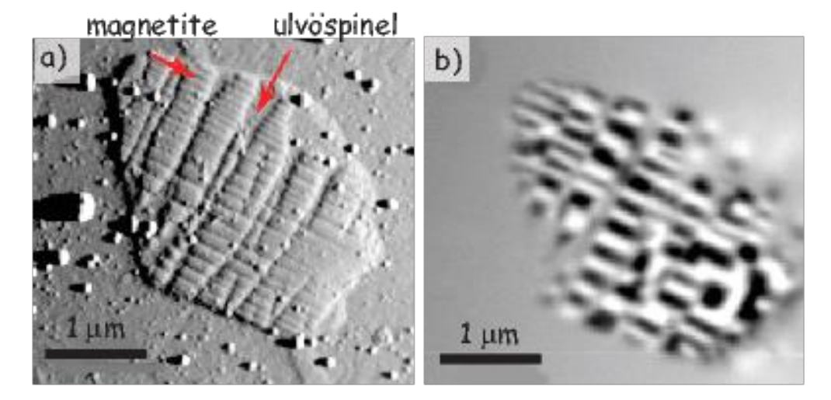
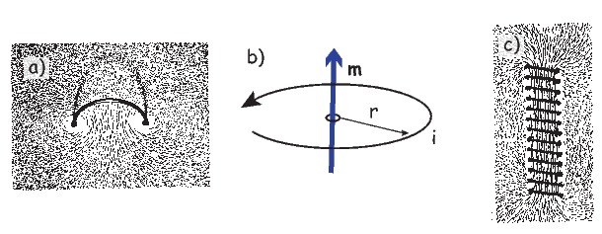
Natural remanent magnetization
Conserved fossil magnetic field
Fe-Ti oxide minerals
Captured at point of heating
Can be reset
magnetic flux (magnetic moment), velocity, magnetic susceptibility
Iron Filings

Slide 53
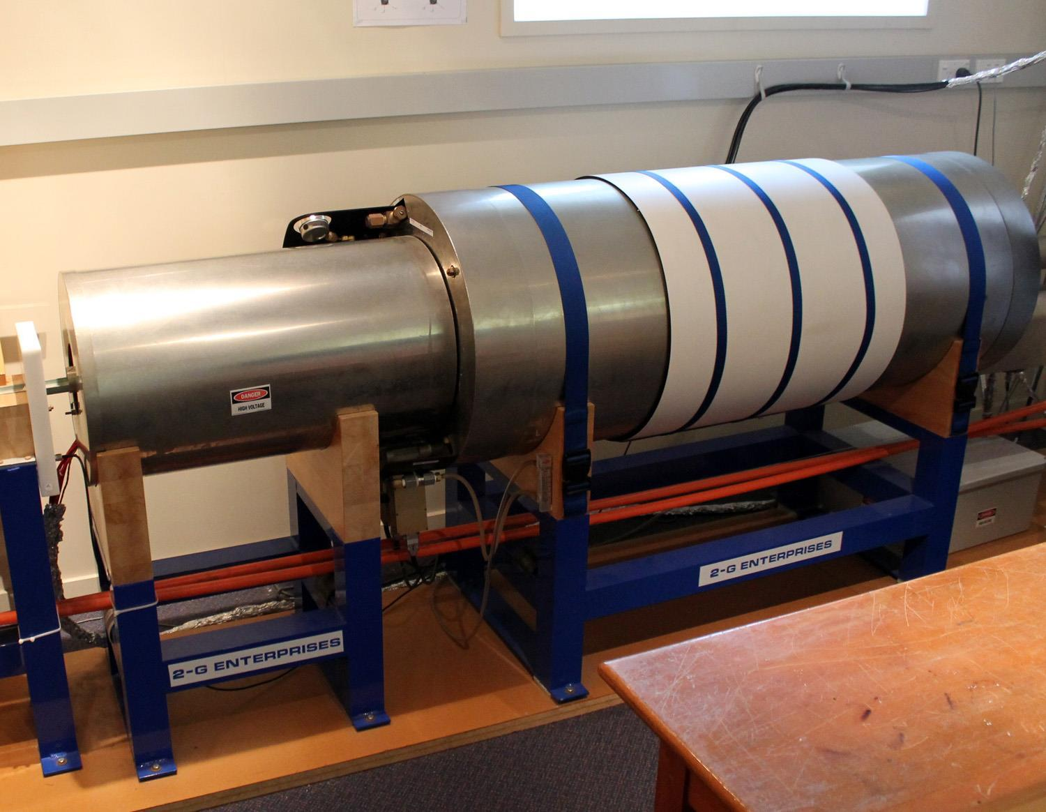
Measurement?
Magnetometer!
Notes:
Remember declination and inclination have to be accounted for at present and during emplacement.

Slide 54
Concepts to cover next week
Plate Reconstruction for Palaeontologists
Apparent Polar Wander
True Polar wander
Plate Rotations
Reference Frames
But First

Slide 55
Notes:
APW is earth relative.
TPW corrected for earths situation in the cosmos

Slide 56
Notes:
Merdith et al 2021.
Add it all together (with a few other things) and you get yourself a Plate Reconstruction.
Tectonic time-lapse: One billion years of Earth’s history in 40 seconds

Slide 57
Extension Questions
What is plate tectonics?
When did plate tectonic start?
Why would we look for plate tectonics on other planets, e.g. Mars?
What data exists for palaeolongitude?
What can we use plate reconstructions for?

Slide 58
Let’s Download the program.
GPlates setup | GPlates for System Erde III. (adamtkocsis.com)

Slide 59
References
Ortelius, Abraham. 1596. Thesaurus Geographicus.
Lu, G., Zhao, L., Chen, L., Wan, B. and Wu, F., 2021. Reviewing subduction initiation and the origin of plate tectonics: What do we learn from present‐day Earth?. Earth and Planetary Physics, 5(2), pp.123-140.
Merdith, A.S., Collins, A.S., Williams, S.E., Pisarevsky, S., Foden, J.D., Archibald, D.B., Blades, M.L., Alessio, B.L., Armistead, S., Plavsa, D. and Clark, C., 2017. A full-plate global reconstruction of the Neoproterozoic. Gondwana Research, 50, pp.84-134.
Snider-Pellegrini, Antonio. 1858. La Création Et Ses Mystères Dévoilés: Ouvrage Où l’on Expose Clairement La Nature de Tous Les Êtres, Les Éléments Dont Ils Sont Composés Et Leurs Rapports Avec Le Globe Et Les Astres, La Nature Et La Situation Du Feu Du Soleil, l’origine de l’Amérique, Et de Ses Habitants Primitifs, La Formation Forcée de Nouvelles Planètes, l’origine Des Langues Et Les Causes de La Variété Des Physionomies, Le Compte Courant de l’homme Avec La Terre, Etc. Librairie A. Franck.
Straume, E.O. , C. Gaina, S. Medvedev, and K.H. Nisancioglu (2020), Global Cenozoic Paleobathymetry with a focus on the Northern Hemisphere Oceanic Gateways, Gondwana Research, 86, 126-143. https://doi.org/10.1016/j.gr.2020.05.011
Wegener, Alfred. 1912. “Die Entstehung Der Kontinente.” Geologische Rundschau 3 (4): 276–92. https://doi.org/10.1007/BF02202896.

